Slide 1

AtliQ Hardware Ad-hoc Insights
Domian : Consumer Goods

Slide 2
Objectives :-
AtliQ Hardware, a fictional corporation, is a prominent computer hardware manufacturer in India with a strong international footprint.
Despite its potential, the management has identified a need for more timely and informed decision-making.
To address this, there's a strategic initiative to strengthen the data analytics team by recruiting junior data analysts.
The company has identified 10 specific ad hoc requests for which they are seeking valuable insights.

Slide 3
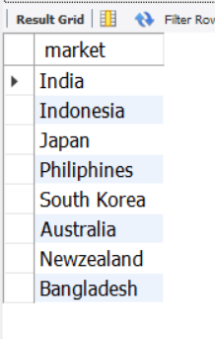
Query 1 . Provide the list of markets in which customer "Atliq Exclusive" operates its business in the APAC region.
OUTPUT
INSIGHTS : - AtliQ Exculsive operates its business in eight countries within the APAC region.

Slide 4
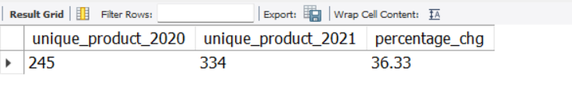
QUERY2. What is the percentage of unique product increase in 2021 vs 2020?
OUTPUT :-
INSIGHTS :- In the fiscal year 2020, we had a total of 245 products, which increased to 334 in the fiscal year 2021, marking a 36% growth.

Slide 5
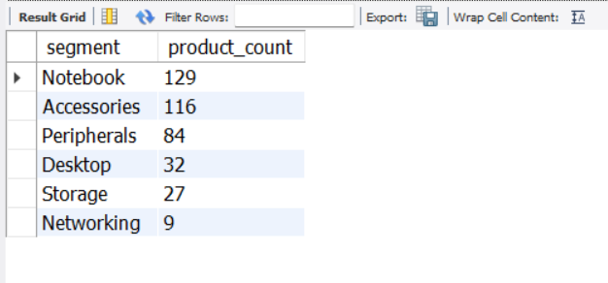
Query 3 . Provide a report with all the unique product counts for each segment and sort them in desecnding order of product counts .
OUTPUT:-
INSIGHTS :- Notebooks , Accessories and Peripherals are three top segments.

Slide 6
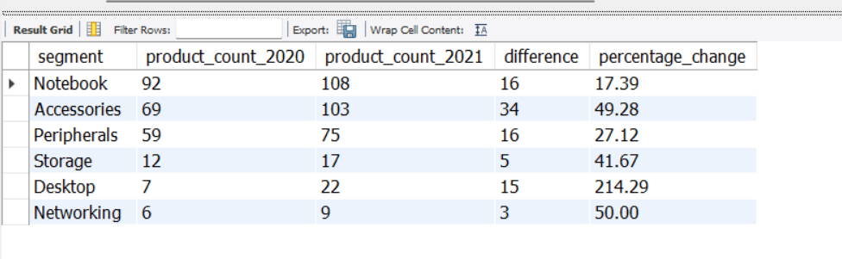
Query 4 . which segment had the most increase in unique products in 2021 vs 2020?
OUTPUT :-
INSIGHTS :- Accessories segment had the most unique product in 2021 vs 2020.

Slide 7
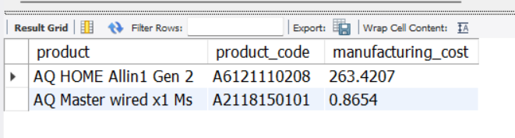
Query 5 . Get the products that have the highest and lowest manufacturing costs.
OUTPUT :-
INSIGHTS :- AQ HOME Allin1 Gen 2 has the highest manufacturing cost and AQ Master wired x1 MS has the lowest manufacturing cost.

Slide 8
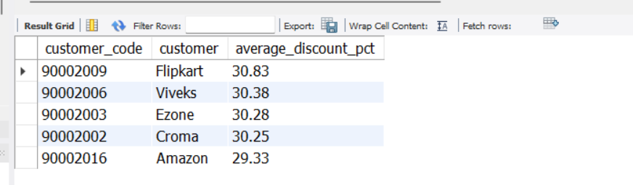
Query 6 . Generate a report which contains the top 5 customers who received an average high pre_invoice_discount_pct for the fiscal year 2021 and in the Indian market.
OUTPUT :-
INSIGHTS :- Flipkart , Viveks ,Ezone ,Croma, Amazon are the top 5 highest average discount percentage for the fiscal year 2021 in Indian Market.

Slide 9
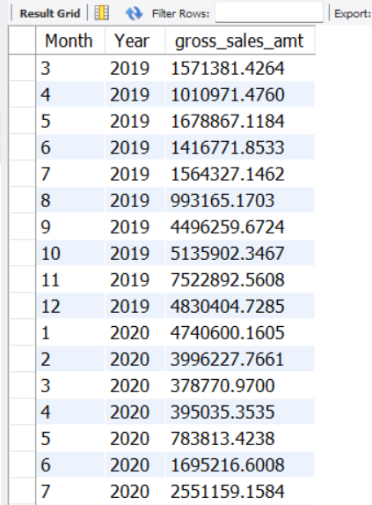
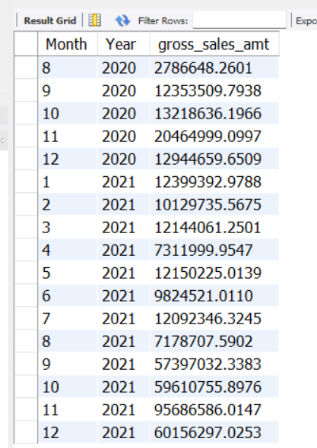
Query 7 . Get the complete report of the gross sales amount for the customer "AtliQ Exclusive" for each month. This analysis helps to get an idea of low and high performing months and take strategic decisions
OUTPUT :-

Slide 10
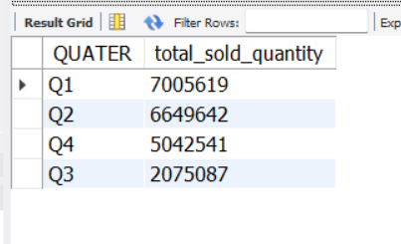
INSIGHTS :- In 2019, September was the lowest performing month, while November saw the highest performance. For 2020, March was the lowest performing month, with November again being the highest.
Query 8 . In which quarter of 2020, got the maximum total_sold_quantity?
OUTPUT :-
INSIGHTS :- The first quarter of 2020 (September, October, November) saw the highest number of products sold.

Slide 11
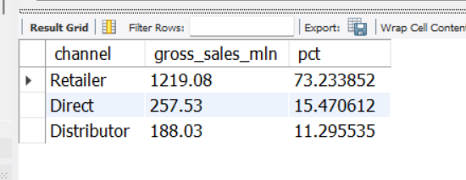
Query 9 . Which channel helped to bring more gross sales in the fiscal year 2021 and the percentage of contribution?
OUTPUT :-
INSIGHTS :- The retailer channel significantly boosted gross sales in fiscal year 2021, contributing 73.23%.

Slide 12
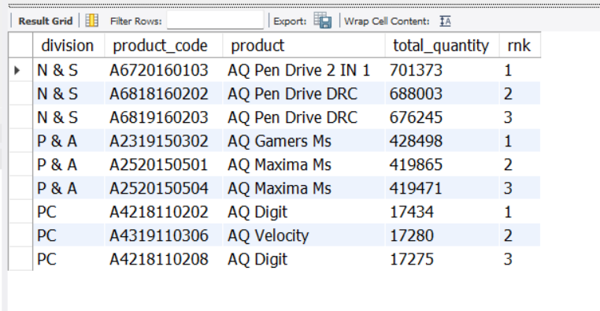
Query 10 . Get the Top 3 products in each division that have a high total_sold_quantity in the fiscal_year 2021?
OUTPUT :-
INSIGHTS :- The top-selling products in fiscal year 2021 were as follows:
N&S Division: AQ Pen Drive 2 in 1, AQ Pen Drive DRC
P&A Division: AQ Gamers MS, AQ Maxima MS
PC Division: AQ Digit, AQ Velocity

